Slide 1



QSI
Supervisory Board Meeting
12 May, 2025

Slide 2

In a nutshell:
ECONOMIC SITUATION.
EVENTS.
DELIVERABLES 2025-2026. MILESTONES YET TO BE ACHIEVED. COMPLEMENTARY SKILLS. OUTREACH ACTIVITIES.
QSI SCIENCE ART CONTEST. AMENDMENT.
SUMMARY FOR DCs.

Slide 3
ECONOMIC SITUATION I:
Common Pot.
All the APs contributed to the Common Pot like the beneficiaries. Reminder: 8.125 € per DC, total: 97.500 €.
2º Payment from the EU. (Received!) Payments from the Common Pot:
Kick-off Meeting in Amsterdam, School of Padua (SQC),
School of Tu/e (PQC) (Porto),
Workshop in Copenhague, Conference in Paris,
DONE. DONE. DONE.
Pending.
Pending.

Slide 4

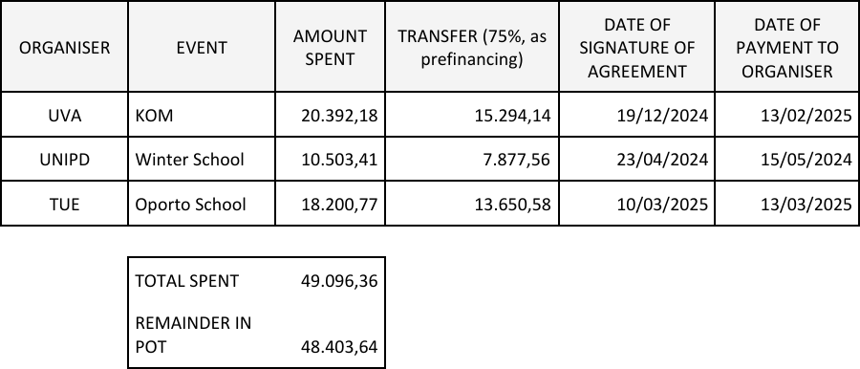

ECONOMIC SITUATION II:
Remaining money:
+€97.500 (Common Pot) - €49.096,36 (Events) = € 48.403,64.
+€48.403,64: Workshop in Copenhagen, Conference in Paris & Expo in Osaka.

Slide 5

ECONOMIC SITUATION III:
For next payments:
Please note that,
for the signing of agreements and
to pay for you the events from the Uvigo,
we will ask you an
Official Electronic Signature
or
Acrobat Sign.

Slide 6

EVENTS I:
Next events:
QSI at World Expo 2025 in Osaka, Japan.
August, 8-12.
3 people representing the QSI project (Alex Grilo, Christian Majenz and Alessandro Marcomini) and eventually a fourth person pending to be confirmed.
Prof. Kiyoshi Tamaki from Toyama University and Dr. Koji Azuma from NTT have confirmed that they will attend the event.
Dissemination talks:
Talks about quantum communication technologies provided by A. Grilo (English). Talks about post-quantum technologies (PQC) provided by a C. Majenz (English). Dissemination talk provided by a doctoral candidate Alessandro Marcomini (English).
Talks about quantum communication technologies provided by K. Tamaki and K. Azuma (Japanese).
Dissemination videos of Doctoral Candidates (Deadline 15/06/25) .
Outreach Activities for children and families.
Winner of the QSI Art Contest.

Slide 7
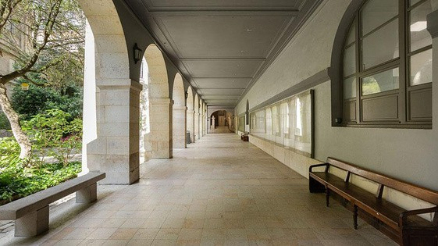
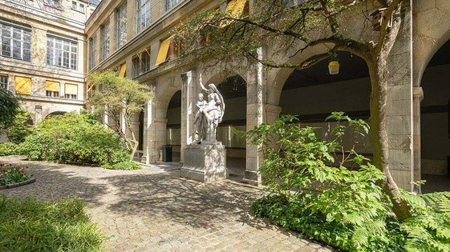
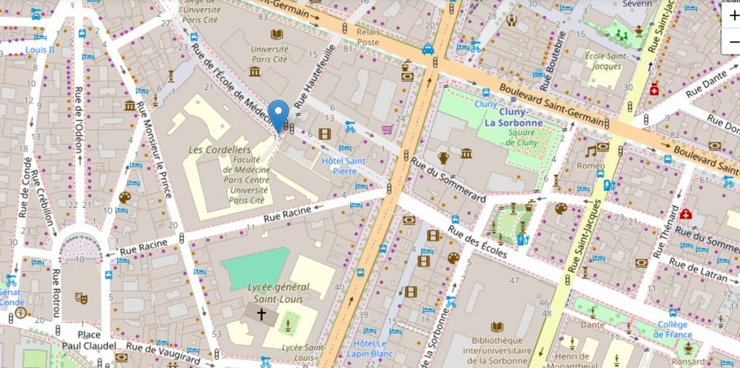
EVENTS II:
Next events:
QSI Conference, Paris -> 2026.
When?
Where?
The week of March 16 to 20, 2026, including the QSI OPEN DAY!
The amphithéâtres of Campus Cordelier, University of Sorbonne.
Joint Conference:
QSI <-> QuanTiP conférence
https://quantip.org/

Slide 8
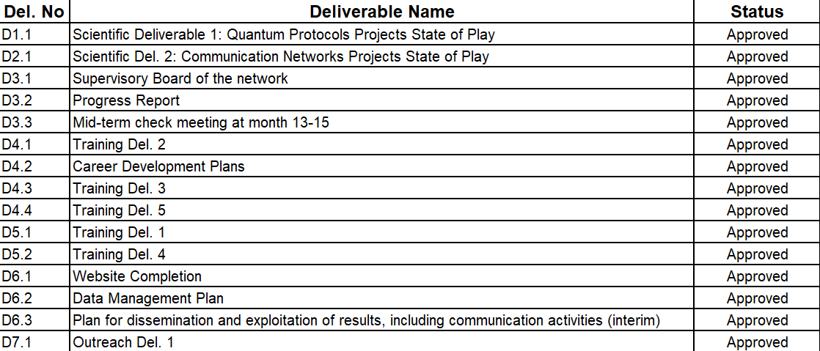

DELIVERABLES I:
All Deliverables have already been approved!!!

Slide 9
DELIVERABLES II:
Urgent Deliverables: May, 2025:
31/05/2025 -> D1.2 Scientific Deliverable Del. 3 31/05/2025 -> D2.2 Scientific Deliverable Del. 4
The info for the Scientific Deliverables was requested to the DCs on April, 8 and the deadline is
May, 15.
31/05/2025 -> D5.3 Training del 6. CS3
The info for the CS3 was already asked to Fabrizio Sisinni, please before 20/05/25.
31/05/2025 -> D6.4 Del1. Workshop
The info for the D6.4 was already asked to C. Majenz and F. Sisinni, please before 20/05/25.
30/09/2025 -> D7.2 Outreach Del.2 Public Talks - Art Contest

Slide 10

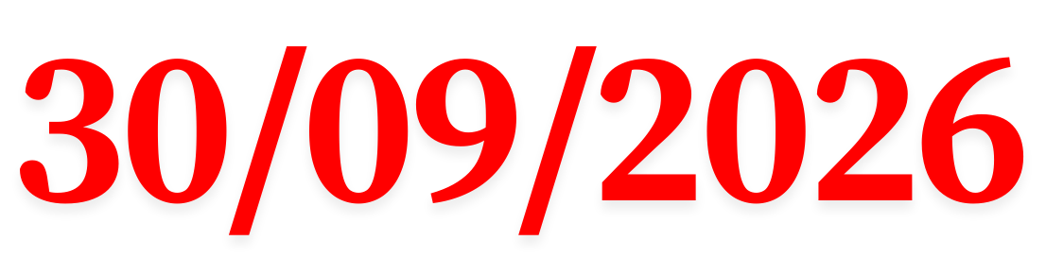
DELIVERABLES III: Final year, 2026:
D1.3 -> Scientific Del. 5: Quatum Protocols Projects State of Play, Final reports: Each DC, from DC1 to DC5, will submit a final report on his/her project.
D1.4 -> Scientific Del. 7: Quantum Protocols Demonstrator, Demonstrators/prototypes for MPC protocols. (Lead Beneficiary, SU).
D1.5 -> Scientific Del. 9: Roadmap for future QS technologies, Roadmap/White Paper for future QS technologies. (Lead Beneficiary, RUB). Organize a small group and start working on it.
D2.3 -> Scientific Del. 6: Communication Networks Projects State of Play, Final reports: Each DC, from DC6 to DC10, will submit a final report on his/her project.
D2.4 -> Scientific Del. 8: Communication Network Demonstrator, Demonstrators/prototypes for high- rate long-distance QKD in free-space and telecom fibre. (Lead Beneficiary, UNIPD).
D3.4 -> Regular meetings, SB, RM, RC, TC, DIC, IAB, DF meetings.

Slide 11





DELIVERABLES IV: Final year, 2026:
D4.5 -> Training Del. 7, PhD awards for graduating DCs.
D6.5 -> D&I Del. 2, Digital newsletter distribution.
D6.6 -> D&I Del. 3, International Conference presentations. D6.7 -> D&I Del. 4, Quantum-Safe Internet Conference, (Paris). D6.8 -> D&I Del. 5, Publications in high-impact journals.
D6.9 -> Plan for dissemination and exploitation of results, including communication activities (final).
D7.3 -> Outreach Del. 3, Story of the month on web site.
D7.4 -> Outreach Del. 4, Outreach Day 3: QSI Open Day.

Slide 12
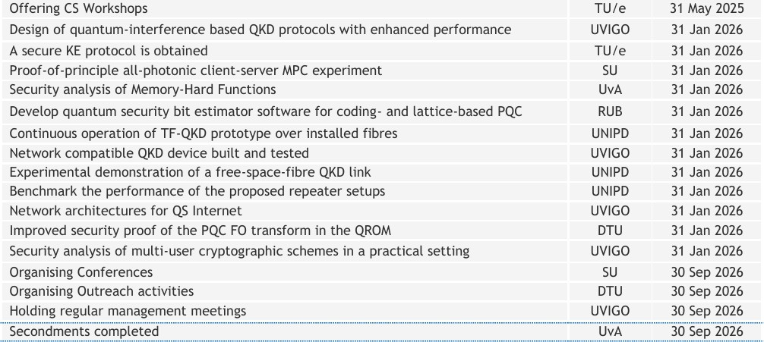
MILESTONES YET TO BE ACHIEVED:
TOSHIBA
UGeneve
ULeeds
Demonstration of new hardware architecture for high-performance quantum-safe internet
IDQ.

Slide 13
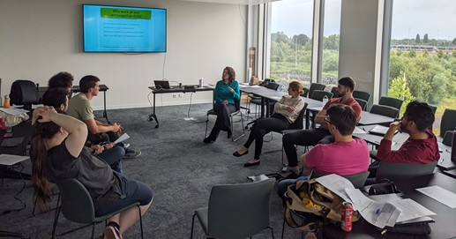
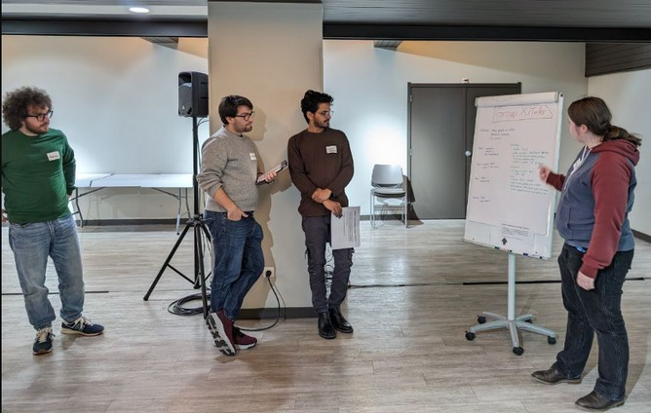
COMPLEMENTARY SKILLS:
CS 1. In Amsterdam ->Done. CS 2. In Porto ->Done. CS 3. NOW in Copenhague.

Slide 14


OUTREACH ACTIVITIES:
Outreach Day 1 (OD1), Engaging in local public-science events.
(Pending: Shashank Kumar)
Outreach Day 2 (OD2), Science Art Contest.
(Pending: Sergio Javier, Toshiba.)
ALMOST DONE!
ALMOST DONE!
(We might need to reactivate it if we move the QSI Science Art Contest to Paris.)
Outreach Day 3 (OD3), QSI open day. Pending, Paris, 2026.
In conjunction with the QSI Conference, we will organize an Open Day, where members of the public will be invited to public lectures, given by lead scientists in the field, demonstrations, and (virtual) laboratory tours based on the QSI’s research and industrial partners. They will have the opportunity to talk one-on-one with all the DCs and scientists involved and learn about their work first hand. This will be done in 2026 during the QSI Conference in Paris.

Slide 15
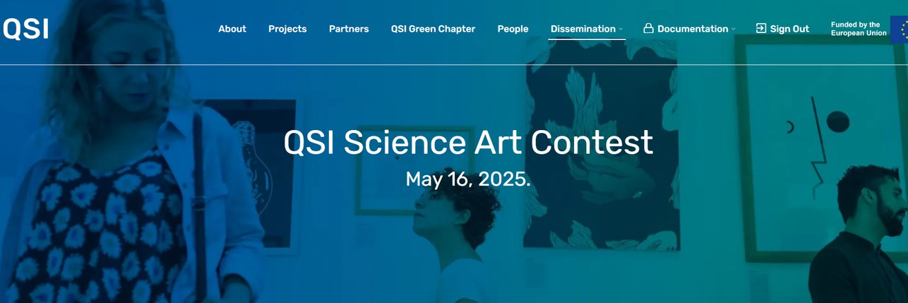
QSI SCIENCE ART CONTEST:
Create a committee.
Postpone until March 2026.
More advertisement of the QSI Science Art contest.

Slide 16
AMENDMENT:
Secondments: On April 2025 the PO accepted changes for secondments DC5, DC8 and DC10.
We do not expect more changes in secondments, but if there is any,
please inform us asap, to ask for permission to the PO.
We will have to make an amendment before finalizing the project, including the modifications of the secondments, other possible modifications that may arise, and the deviations we have encountered.

Slide 17
Summary for DCs
Coming soon...
Reminder
Inform us about...
Publications!! Secondments.
Milestones.
Outreach Activities.
Career Development Plan (Years 3-4)
Please use the template.
Deadline 30/04/2025.
3 DCs pending.
Story of the Month
Keep doing
3ª Newsletter
After the Workshop in Copenhague
QSI Green Chapter
Keep in mind
Progress Report
Please use the template
After the Project
END 2025 AND
END 2027: FILLING OUT THE EU FORMS
Personal Video
Keep your profile updated
Videos for Osaka Expo.
Deadline: 15/06/2025.

Slide 18
Thank you!

