Slide 1
Nina Poumpalova
QSI
15 December 2023 - remote

Slide 2

Agenda
MTM objective
Assessment of recruitment / Reminder of DCs rights & obligations
Project Management
Reporting & finance
Communication, Dissemination, Exploitation, Synergies
Useful links & reference documents

Slide 3
Meeting objectives
MSCA DOCTORAL NETWORKS

Slide 4

MTM - Objectives
Meet the consortium
Assess the recruitment process (and the eligibility of fellows)
Monitor & assess the project’s progress
Discuss and agree on potential amendment(s)
Prepare the next steps (RP1 reporting)
Keep minutes!
Discuss potential issues, risks and contingency measures
Remind beneficiaries & fellows of their rights and obligations

Slide 5
Recruitment DCs rights & obligations
MSCA DOCTORAL NETWORKS

Slide 6

Assessment of Recruitments
Recruitments
Should have been advertised to the wider audience possible (EURAXESS, website, social media, mailing lists, personal accounts)
Vacancy had to indicate gross salary (without employer’s social contribution)
Process
Selection process was included in vacancy notice
Structured interviews were organised with predefined questions and scoring system
The selection committee had the required expertise, gender/nationality balance
The process was documented (results and application statistics were submitted in the Recruitment Deliverable)
Fellows
DCs were recruited following an open, transparent, merit-based, impartial and equitable process
The eligibility conditions for fellows were respected (and documented)

Slide 7
MSCA Doctoral Candidates (DCs)
CONTRACTS
DCs were recruited under a contract fully compliant with Annex 5 of the GA.
The contract mentions inter alia:
the project number/acronym;
the duration of the research training activity;
the monthly support for the researcher (in EUR);
the contract should be in a language the DC understands (if necessary, English translation should be provided).
Mobility DeclarationS
A mobility declaration was submitted after the recruitment of each researcher.
Fellows
All DCs:
Have a personalized CDP (see EURAXESS guidance);
Receive proper supervision (see Supervision guidelines);
Have received General Info package for MSCA fellows and the Info package for DN fellows;​
Are aware of the Code of Conduct for the Recruitment of Researchers & the European Charter for Researchers;

Slide 8


MSCA Doctoral Candidates (DCs)
Fellows
DCs:
were informed about their role in the project and properly integrated;
are aware of the GA provisions, working conditions (employment contracts, eligible allowances, visa issues, administrative support), tuition fees;
are aware about the possibilities offered to them via the network and outside of it (e.g., network meetings, workshops/international conferences, complementary skills training, etc.);
should ensure visibility and recognition of received EU funding in communications, publications and patent applications;
have appropriate secondment opportunities (if necessary, the secondment plan can be updated);
are paid according to the established MSCA rates (tuition fees and visa related fees should be covered by the consortium).

Slide 9
Reporting
MSCA DOCTORAL NETWORKS

Slide 10
Role and responsibilities - Coordinator (Art.7)
The coordinator must:
Monitor the project implementation
Act as Intermediary for all communications between REA and the consortium
Request and review documents/information required by the REA
Submit deliverables and reports to the REA
Distribute payments without unjustified delay and
The coordinator cannot delegate/sub-contract these tasks (to any other entity incl. affiliated entities)*
*Exception for public bodies - Authorization to administer: the coordinator may delegate these two tasks to a third party with “authorization to administer” created, controlled or affiliated to it, but it retains sole responsibility for the payments and for compliance with the GA

Slide 11
Role and responsibilities - Beneficiaries (Art.7 & 19)
Technical implementation
=
joint liability
Beneficiaries
Provide any information requested by REA to verify the eligibility of costs, the compliance to the GA and the proper project implementation;
Keep up to date the info in the Portal Participant Register
Inform the REA (& other beneficiaries) immediately of any event affecting the project implementation
Submit to the coordinator in good time the individual financial statements, contribution to deliverables and technical reports, etc.
Financial responsibility
=
individual (own debt)

Slide 12
Roles and responsibilities - project implementation (Art.11) and reporting (Art.21)
Article 11.1: Obligation to properly implement the action “The beneficiaries must implement the action as described in Annex 1 and in compliance with the provisions of the Agreement”
Article 21: Reporting Necessary to assess and verify:
That the project is implemented as described in Annex 1 (scientific assessment);
That the project's activities comply with the obligations under the GA.

Slide 13
Project timeline
RP1
RP2
Periodic technical report
Individual financial statements
Periodic technical report
Individual financial statements
Progress report
Start
12M
24M
36M
48M
Recruitment
MID-TERM CHECK (M13-15)
INTERIM REVIEW
(M24-26)
FINAL REVIEW
(M48-50)
CONTINUOUS REPORTING
Publishable Summary, Deliverables, Milestones, Critical Risks, Publications, Results, Dissemination activities, Standards, Patents, Communication activities, Datasets, Mobility and Other Results

Slide 14

Continuous reporting
Opens at the start of the project
All beneficiaries receive a notification to contribute
The continuous reporting is collaborative
To contribute, beneficiaries must log on to the Funding & Tenders Portal and access the relevant project
Purpose
Allow COOs to contribute on an ongoing basis to provide regular updates on the status of the project
See Online Manual for step-by-step online guidance

Slide 15
Continuous reporting
All fields are mandatory.
Who? Milestones and deliverables should be submitted by each participant for their work.
What? You should report on milestones and submit deliverables following the deadlines set out for them.
The Continuous Reporting Module also allows you to report on critical risks, prepare the summary for publication and the programme-specific information on indicators.
All this information is automatically compiled to create part A of the periodic Technical Report, at the end of each reporting period.

Slide 16


Mandatory reporting
Supervisory
board of the network
Mobility Declaration
Progress report (M13)
Mid-term check (M13-15)
To be submitted within 20 days after the recruitment of each fellow
Career Dev. Plan
DMP (M13 & M48 if needed)
D&E, communication plan (M13 & 48)
Evaluation
Questionnaire
To be submitted at the end of the fellowship; and two years later
To be updated in Mobility Declaration

Slide 17
The 3 tables of the ‘Mobility’ tab
RESEARCHERS
Encoding of Researchers' personal details.
Serves as database from which Mobility Declarations (MDs) can be automatically prefilled
SECONDMENTS
Secondments are additional periods of research training with another beneficiary or associated partner (to be encoded in this tab)
MOBILITY DECLARATIONS
The Mobility Declaration (MD) links the researcher to the recruiting institution & specifies the recruitment period(s)

Slide 18
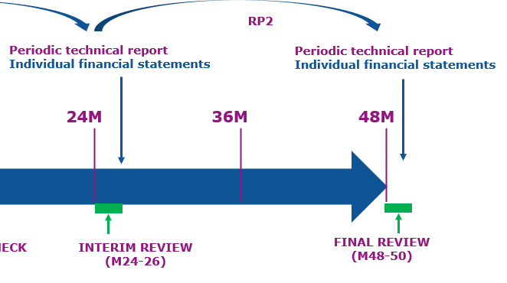
Projects reviews (end RP1 and RP2)
See also Article 25
To assess the project's progress, including the assessment of the reports and deliverables of each reporting period, the REA will organize an interim / final review
When? At the end of each reporting period
The COO needs to submit the IFSs and the technical report (see Art. 21)
The reviews are done remotely unless otherwise agreed with the PO
They can be carried out with the help of an external expert

Slide 19
Cost categories
1 Unit = 1 month eligible DC (Doctoral Candidate)
A. Contributions for recruited researchers |  |  |  |  | B. Institutional contributions
A1. Living allowance (€) | A2. Mobility allowance (€) | A3. Family allowance (if applicable) (€) | A4. Long term leave (if applicable) (€) | A5. Special needs (if applicable) (€) | B1. Research training and networking contribution (€) | B2. Management and indirect contribution (€)
3400* | 600 | 660** | 4000 x % covered by the beneficiary** | requested unit x 1/ number of PM** | 1600 | 1200
*multiplied by country correction coefficient
**the total family allowance indicated in Annex 2 of the grant agreement represents an average which is based on the assumption that 75% of the Doctoral Candidates will be entitled to a family allowance
***if applicable
Notes:
There are 2 types of cost categories:
Researcher costs (goes directly to the researcher) – these values are based on Belgian numbers
And Institutional costs
To ensure equal treatment and purchasing power for all researchers, the amount for the living allowance is adapted per country, by applying a country-specific correction coefficient.
The list of coefficients is published in the Horizon Europe Work Programme (page 109- MSCA) in force at the time of the call.
ECB's official website for the exchange rate https://www.ecb.europa.eu/euro/exchange/html/index.en.html

Slide 20
Communication, Exploitation and Dissemination Synergies
MSCA DOCTORAL NETWORKS

Slide 21
Contractual obligation
Horizon Europe Model Grant Agreement
“Unless otherwise agreed with the granting authority, the beneficiaries must promote the action and its results by providing targeted information to multiple audiences (…)”
Article 16: Intellectual Property Rights (IPR) – Background and Results – Access Rights and Rights of Use
Article 17: Communication, Dissemination & Visibility
Specific rules in Annex 5 of the GA

Slide 22
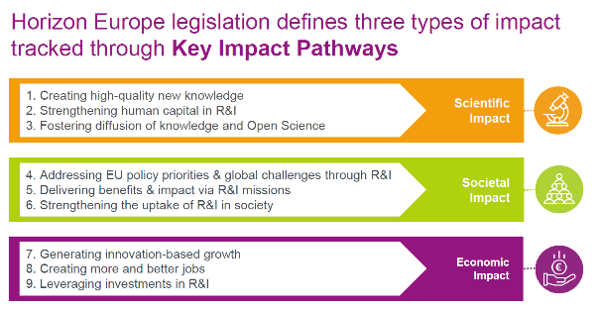
Why communication, dissemination & exploitation are important?
Maximize the impact of project results
“A pathway begins with the projects’ results, to their dissemination, exploitation and communication, contributing to the expected outcomes in the work programme topic, and ultimately to the wider scientific, economic and societal impacts…”

Slide 23
What’s in it for you?
Improves your chances of success
Enhances visibility/ reputation & helps gain understanding and support
Facilitates the exploitation of results
Supports spread of knowledge & allows knowledge to be built upon
Attracts potential partners/future long-lasting collaborations
Opens up other funding & business opportunities
Generates market demand for developed products, services

Slide 24

Website & other communication channels
COMM channels
Establish them ASAP
Acknowledge EU Funding
Involve DCs in the comm., dissemination & exploitation activities
Promote action & results to maximize their impact
Use social media
Create website
Present the partners of the project and the individual research projects
When fellows are selected, include a short bio
Include links to social media
Include links to CORDIS and the accepted deliverables

Slide 25
Publications
Ensure open access to peer-reviewed scientific publications;
Immediate open access is required i.e. at the same time as the first publication, through a trusted repository; Beneficiaries/authors must deposit their publication in a machine-readable format in a trusted repository before or at publication time and immediately provide open access to the publication through that repository.
In the Continuous Reporting, include journal articles, conference proceedings, posters, etc.;
Advertise the accepted papers and promote co-authorship among fellows.
A new OA publishing platform is now available: Open Research Europe

Slide 26


Tips
Success Stories Criteria
High visibility/media attractiveness
Significant impact on EU policies
Outstanding use/exploitation of results
Breakthrough innovation(s)
Significant impact on the career of researchers
Significant impact on SMEs
Inform REA of:
Important press releases
Important events that will receive media attention
Innovative outreach activities
Awards to fellows
Social media accounts
Promote Social media use:
Use the following hashtags to have a bigger impact: #MSCA #DoctoralNetworks #HorizonEurope

Slide 27
Useful links and reference documents
MSCA DOCTORAL NETWORKS

Slide 28
Useful links
Funding & tender opportunities portal
Reference documents
Partner search
Online manual
IT How to
Project & results
Participant register
MSCA website

Slide 29
Other documents
Work programme
Grant Agreement
Annotated Grant Agreement (still in draft, currently being finalized)
General Info Package for MSCA Fellows
Info Package for MSCA DN Fellows
NCP – National Contact Points
MSCA Alumni Association
MSCA guidelines for supervision
The Code of Conduct for Recruitment and Charter for researchers
Coordinator’s Info Day DN2021

Slide 30
Thank you!
# HorizonEU
http://ec.europa.eu/horizon-europe

